Slide 1

The only way is ethics. moeseg a deallusrwydd artiffisial
Jonathan Gabay

Slide 2

The Golden Rule
Treat others as you would like others to treat yourself
(in a positive or directive form).
Do not treat others in ways that you would not like to be treated
(negative or prohibitive form)
What you wish upon others, you wish upon yourself (empathetic or responsive form).
Similar to the Hillel Rule: (Died 10 BCE)
"What is hateful to yourself, do not do to your fellow man”.

Slide 3

The Silver Rule
Confucius (551 – 479 BCE)
Do not do unto others what you would not have done to yourself.
For example, if you would not enjoy being harmed or defrauded in some way, you should not do anything that harms or defrauds others.

Slide 4
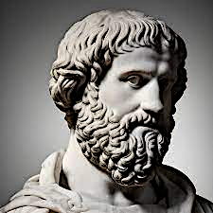
Virtue ethics (τέλος)
Aristotle
Everything has a purpose (Tilos)
E.G. The purpose of a pen is to write
  A pen is good if it writes well.

Slide 5

Τέλος (Tilos) : humans
The rational pursuit of happiness

Slide 6
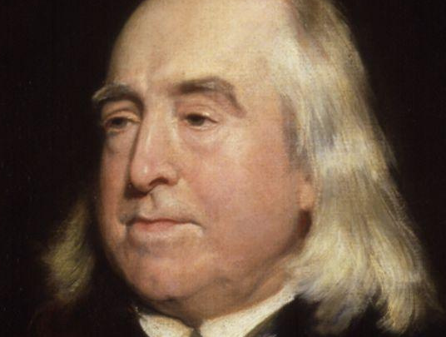
Jeremy Bentham (1748- 1932)
Founder of modern utilitarianism.
Actions are morally right if they:
  Promote happiness or pleasure.
Morally wrong if they :
  Promote unhappiness or pain.

Slide 7

Immanuel Kant (1724 -1804)
Kantian Deontology
We are morally obliged to do the right things.
As well as have moral duties not to do wrong.
No matter the situation, the best moral decision means:
no lying, cheating, or stealing under any circumstances.
﻿﻿Ends don't justify the means.
(Sorry, Machiavelli / Government).

Slide 8
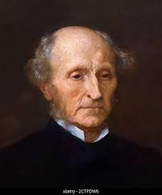
Rule Utilitarianism
John Stuart Mill (1806 -1873)
Beyond a single act - as in ‘Act Utilitarianism’…
Rule Utilitarianism considers sets of rules or guiding principles leading to the greatest happiness or least suffering for the majority

Slide 9
Karl Popper (1902 – 1994)
(Platinum Rule)
Looked to improve on The Golden Rule
(Do Unto Others As They Would Do to You).
Insofar as you're able to understand what other people value and appreciate, try and do that for them

Slide 10

Gold Silver Platinum
Golden Rule
“Treat others the same way you treat yourself.”
Silver Rule
“Don't do things (to other people) if you can't choose for everyone to do them (to you).”
Platinum Rule
“Do what everyone would choose you to do.”

Slide 11


Slide 12


Slide 13

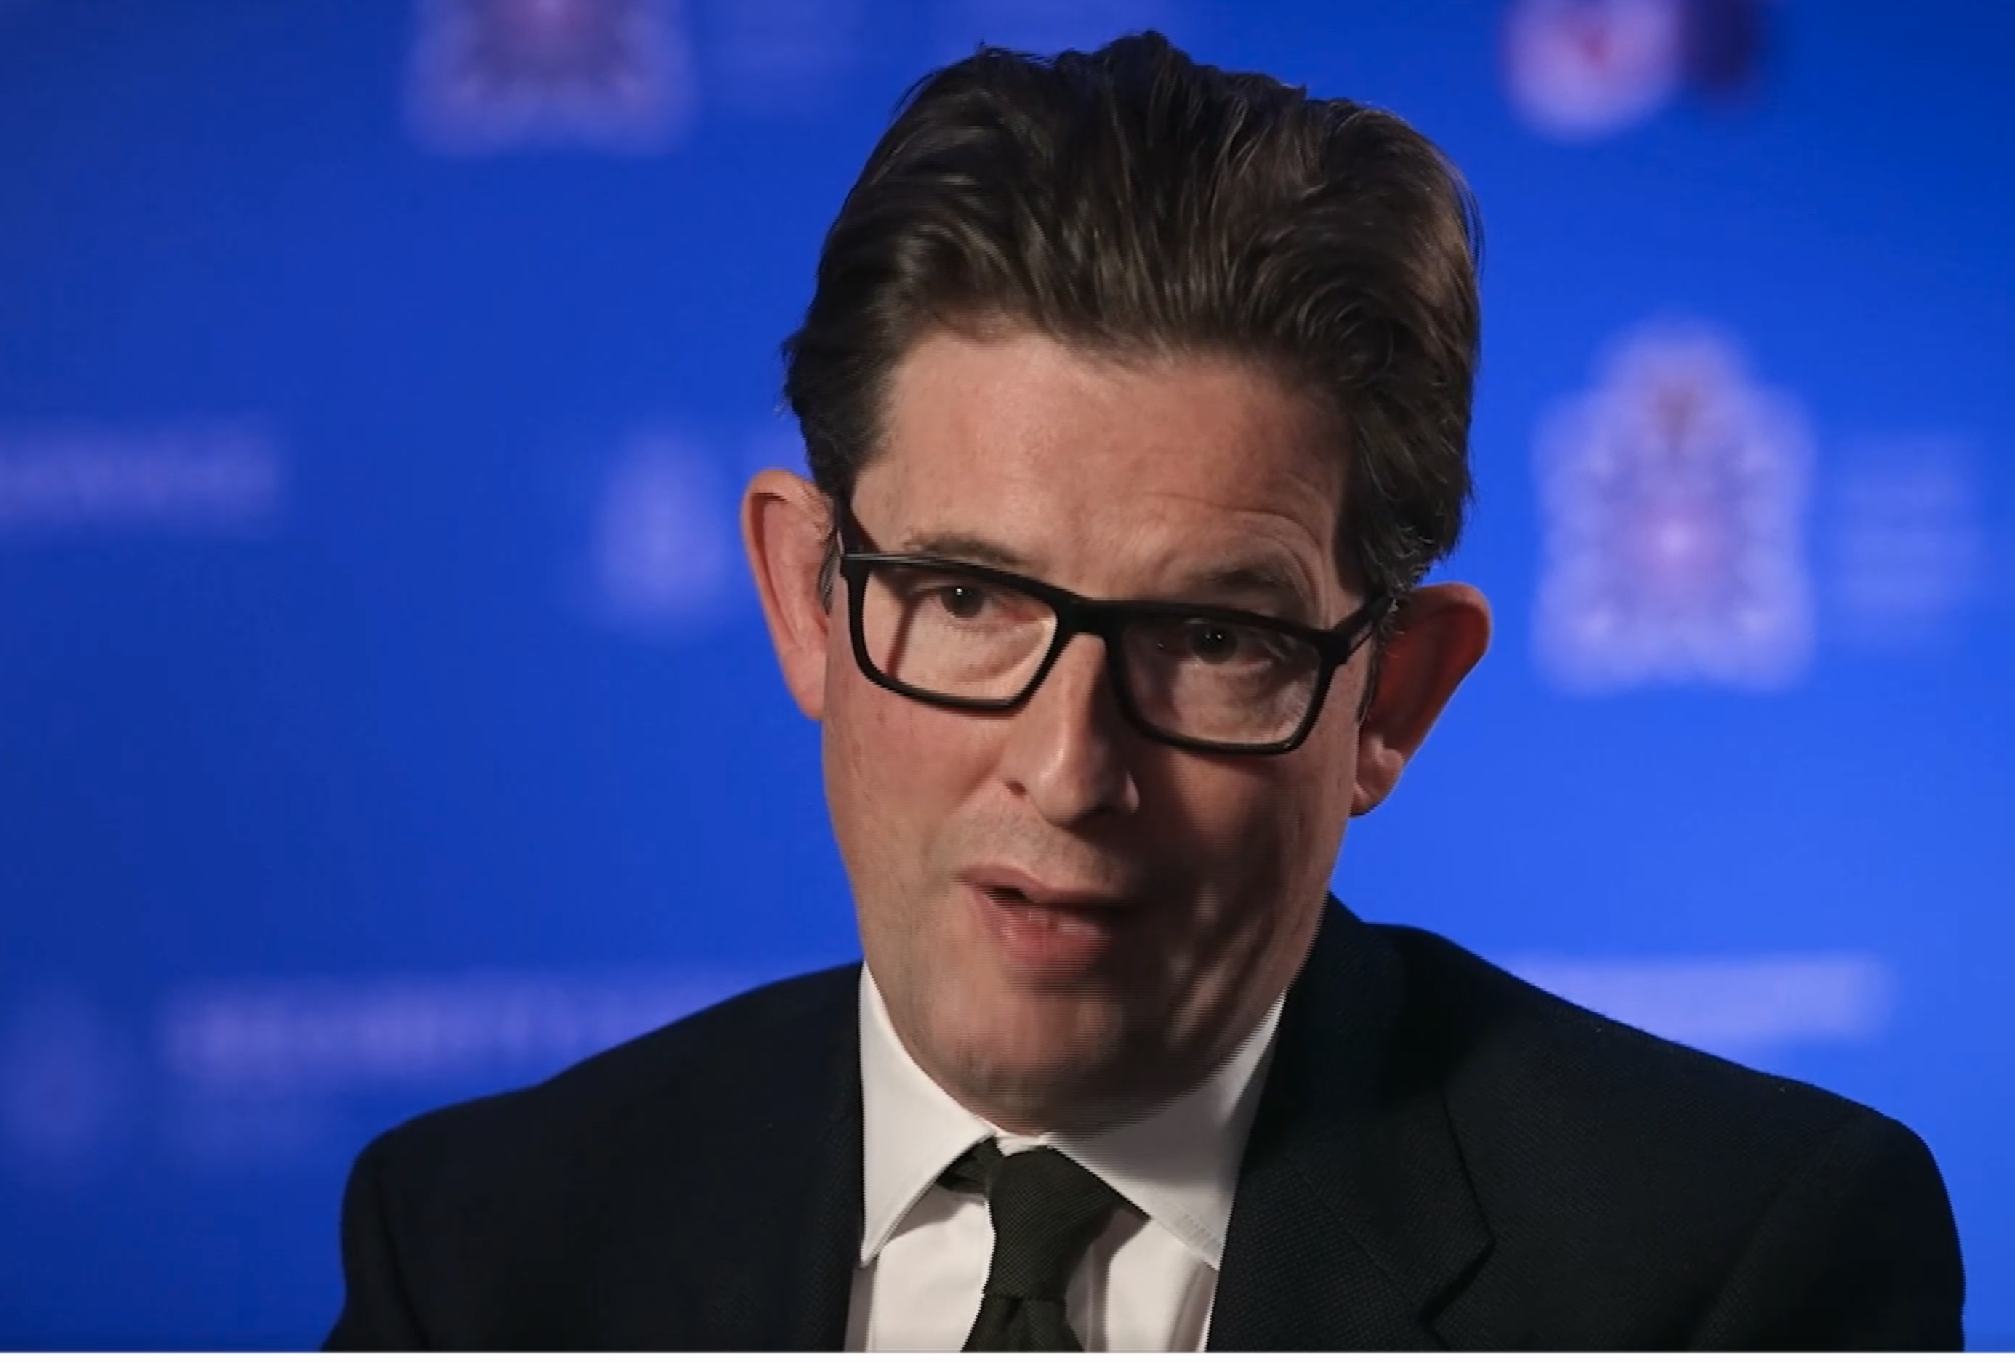


MI5 Director General
Ken McCallum
October 2023
“Deep fake technologies have the potential to cause confusion, dissension and chaos.
The technology has become significantly more sophisticated than was previously the case.
Adversary nations might seek to use these technologies to influence public opinion in all kinds of ways.”

Slide 14

Researchers tested major AI models with benign data
Models achieved 85-95% accuracy in race, location, profession and other personal info from public posts
Example: The model inferred the user was Black based on a public NY restaurant mention
AI models can infer personal data at an unprecedented scale
Poses a severe threat to individual privacy and online security

Slide 15

Concerns about AI being used for mass surveillance
Models could track of individuals without consent
Governments could identify and target groups or individuals
Brands could exploit models for more invasive targeted advertising

Slide 16


Final thoughts
9

Slide 17
123
4
5
6
7
8
9
Comprehensive approach: Strategy - governance,
for responsible AI.
Corporate culture
embraces ethics.

Slide 18
123
4
5
6
7
8
9
Augmentation, not replacement, is advised.
Ensure ethical content aligns with brand values.

Slide 19
123
4
5
6
7
8
9
Vigilance and reassurance
at all stages.

Slide 20
123
4
5
6
7
8
9
Copyright and Legal Exposure
AI tools based on diverse data sources.
Validation of outputs crucial to avoid legal issues.

Slide 21
123
4
5
6
7
8
9
Data Privacy Violations
Generative AI may include personal information
Ensure PI removal and compliance with privacy laws.

Slide 22
123
4
5
6
7
8
9
Generative AI can amplify existing biases.
Diverse leadership and experts are essential.

Slide 23
123
4
5
6
7
8
9
Workforce Roles and Morale
AI is changing the work landscape.
Investment in training is crucial.

Slide 24
123
4
5
6
7
8
9
Data Provenance
AI uses large data volumes.
Address accuracy and data usage transparency.

Slide 25
123
4
5
6
7
8
9
Lack of Context and Interpretability
Generative AI relies on correlations
Model interpretability needed for trust.

Slide 26
CIM’s AI Principles
1
Act ethically and responsibly
2
Ensure quality
3
Be transparent
4
Build AI awareness
  Balance AI's benefits with its potential for misuse
  Be aware AI is only as ethical as the humans that operate it
  Understand Innovation often outpaces regulation and legislation
  Ensuring alignment with brand values is crucial
  Stay updated on AI industry trends, legal regulations, and ethical guidelines for responsible marketing
  Familiarise yourself with AI algorithms and their applications, focusing on data processing methods and ethical considerations
  Monitor emerging AI technologies and be vigilant about potential challenges, engaging with experts and communities for insights into developments and issues
  A planned approach to AI integration is vital to ensure consistency and compliance
  AI enhances productivity, but adherence to quality processes is essential
  Effective prompt engineering is essential
  Marketers need critical thinking to evaluate AI outputs
  Implement multi-step approval processes for accuracy
  Ensure customers are aware when data is being used and processed by AI systems
  It is essential to have a clear data processing policy
  Consider identifying any sensitive information generated by AI

Slide 27
CIM’s AI Principles
3
Be transparent
4
Build AI awareness
1
Act ethically and responsibly
2
Ensure quality
  A planned approach to AI integration is vital to ensure consistency and compliance
  AI enhances productivity, but adherence to quality processes is essential
  Effective prompt engineering is essential
  Marketers need critical thinking to evaluate AI outputs
  Implement multi-step approval processes for accuracy
  Ensure customers are aware when data is being used and processed by AI systems
  It is essential to have a clear data processing policy
  Consider identifying any sensitive information generated by AI
  Stay updated on AI industry trends, legal regulations, and ethical guidelines for responsible marketing
  Familiarise yourself with AI algorithms and their applications, focusing on data processing methods and ethical considerations
  Monitor emerging AI technologies and be vigilant about potential challenges, engaging with experts and communities for insights into developments and issues
  Balance AI's benefits with its potential for misuse
  Be aware AI is only as ethical as the humans that operate it
  Understand Innovation often outpaces regulation and legislation
  Ensuring alignment with brand values is crucial

Slide 28
CIM’s AI Principles
3
Be transparent
4
Build AI awareness
1
Act ethically and responsibly
2
Ensure quality
  A planned approach to AI integration is vital to ensure consistency and compliance
  AI enhances productivity, but adherence to quality processes is essential
  Effective prompt engineering is essential
  Marketers need critical thinking to evaluate AI outputs
  Implement multi-step approval processes for accuracy
  Ensure customers are aware when data is being used and processed by AI systems
  It is essential to have a clear data processing policy
  Consider identifying any sensitive information generated by AI
  Stay updated on AI industry trends, legal regulations, and ethical guidelines for responsible marketing
  Familiarise yourself with AI algorithms and their applications, focusing on data processing methods and ethical considerations
  Monitor emerging AI technologies and be vigilant about potential challenges, engaging with experts and communities for insights into developments and issues
  Balance AI's benefits with its potential for misuse
  Be aware AI is only as ethical as the humans that operate it
  Understand Innovation often outpaces regulation and legislation
  Ensuring alignment with brand values is crucial

Slide 29
CIM’s AI Principles
3
Be transparent
4
Build AI awareness
1
Act ethically and responsibly
2
Ensure quality
  A planned approach to AI integration is vital to ensure consistency and compliance
  AI enhances productivity, but adherence to quality processes is essential
  Effective prompt engineering is essential
  Marketers need critical thinking to evaluate AI outputs
  Implement multi-step approval processes for accuracy
  Ensure customers are aware when data is being used and processed by AI systems
  It is essential to have a clear data processing policy
  Consider identifying any sensitive information generated by AI
  Stay updated on AI industry trends, legal regulations, and ethical guidelines for responsible marketing
  Familiarise yourself with AI algorithms and their applications, focusing on data processing methods and ethical considerations
  Monitor emerging AI technologies and be vigilant about potential challenges, engaging with experts and communities for insights into developments and issues
  Balance AI's benefits with its potential for misuse
  Be aware AI is only as ethical as the humans that operate it
  Understand Innovation often outpaces regulation and legislation
  Ensuring alignment with brand values is crucial

Slide 30
CIM Prompt Engineering workshop
EXTERNAL
INTERNAL
PHILISOPHICAL
Practical
(Support)
Tangible
(Prompts)
(Time, efficiency…)
Companies sell solutions
to external problems.
People buy solutions
to internal problems.
(That’s why, despite buying,
people can still feel ’empty).
Text Here
Text Here
Why?
Why does the product/service/brand matter?
Shared brand/personal causes.

Slide 31



Thank you
reinvent@me.com

